Slide 1






TANGO-Circular Training package
consists of:
Training material : 9 modules
Training courses
8 hours per module per country
2
Face to face
2
Demonstration at the Rural labs
Classification of agricultural biomass.
Valorization of agricultural biomass.
Valorization of agro-food co-products, byproducts and organic residuals.
Classification of agricultural plastic waste.
Collection, transportation and recycling of Agricultural Plastic Waste.
De-contamination and valorization of Agricultural Plastic Packaging Waste.
Waste/Biomass legislation.
Environmental, territorial and economic planning, associated with each form of valorization.
Advantages and disadvantages associated with each possible form of valorization.
2
Practical training
CIRCULAR ECONOMY IN AGRICULTURE
2
On line training
72 hours x course x 4 countries x 3 training rounds
=
864 total training hours
https://tango-circularproject.eu

Slide 2
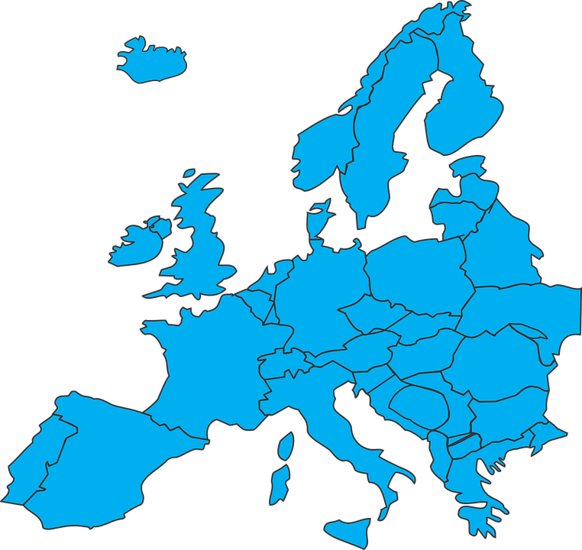


e - learning platform
more…..Training
Download training material
01
Staying tuned on project events
02
Expected outcomes
Communicate with Project Partners
03
Multilanguage tool
English
French
Greek
Italian
Portuguese
Spanish
1000 trainees
250 in every Rural Lab
Learn Anywhere
Anytime
4 Rural labs
Greece
Italy
Portugal
Spain
https://tangocircularproject-vle.eu

